Slide 1
Genetics of Obesity

Slide 2
Learning Objectives
Understand the proportion of obesity that is heritable and how this was determined.
Explain the difference between the effects of inherited environment and genetics.
Understand the role of the environment in the heritability of obesity.
Discriminate between the methodologies used to identify rare and common obesogenic variants.
Apply knowledge of obesogenic variants to potential individualized treatments.
Notes:
Article on race and ancestry in the biomedical sciences

Slide 3
Fatalism vs Personal Responsibility
In the long run, we shape our lives, and we shape ourselves. The process never ends until we die. And the choices we make are ultimately our own responsibility. – Eleanor Roosevelt
I mean, I think we're put here on earth to make your own destiny, to begin with. I don't think there's anything you can do this way or that way to change anything. – Waylon Jennings

Slide 4
Heritability and Correlations

Slide 5
What are some heritable traits?
Polubriaginof, F. C. G. et al. Disease Heritability Inferred from Familial Relationships Reported in Medical Records. Cell 173, 1692–1704.e11 (2018).

Slide 6
A heritability thought experiment
Purpose: Determine effect of genetics on obesity
Study: Send you out to ask 500 random students their BMI, and their parents BMI. Draw do you think the result would look like
What else could explain these associations, what other information would you want
Notes:
W

Slide 7
What graph looks closest to what you drew?
Notes:
10, 50, 77, 90

Slide 8
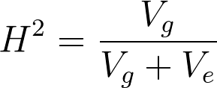
How Heritable do you think BMI is?
Variability Due To Genetics
0-25%
25-50%
50-75%
75-80%
Total Heredity
Best estimate is 77% heritable
What do we we mean here by V_{e}?
How much variance is due to “personal choices”
Notes:
Best estimates are 77%

Slide 9
What proportion of heritability do you think is genetic (V_{g})
Variability Due To Genetics
0-20%
20-40%
40-60%
60-80%
Total Variability
Notes:
0.4-0.6

Slide 10
Some definitions
H² is the fraction of variance explained by heredity
(1-H²) is the fraction of variance not explained by heredity
h² is the fraction of variance calculated from our genes (more on this later)
V_{g} is the fraction of heredity (H²) explained by genetics
V_{e} is the fraction of heredity (H²) explained by shared environment

Slide 11
Genetic vs Shared Environment
Familial (V_{e} + V_{g})
Traits are shared by relatives for any reason
Genetic (V_{g})
Similarities arise from shared genotypes
Activity: List some aspects of obesity that you think would be heritable vs shared environment vs non-heritable.

Slide 12
Race and Genetics
Why is race sometimes considered a social construct and not a useful biological abstraction?
How have have advances in genomics changed how we use race in genetic research?
Notes:
Racial definitions can fluctuate according to social context, geographic location, historical period and personal experience. Indeed, it is not uncommon for the same individual to report their racial identity differently in different contexts and at different points in their lives
the handful of genetic differences used to define the races are socially chosen out of thousands of other differences that are ignored

Slide 13
How To Separate Familial from Heritable?
The experiment we designed calculated the Total Heritability (H²).
To determine proportion that is genetic, we need ways to separate genetics from environments

Slide 14
Twin Studies and Obesity Heritability
This suggests V_{G} ~ 40-60% for the genetic component
Stunkard AJ, Harris JR, Pedersen NL, McClearn GE. The Body-Mass Index of Twins Who Have Been Reared Apart. N Engl J Med. 1990; 322: 1483–7. doi: 10.1056/NEJM199005243222102.

Slide 15
BMI Correlations of Different Sibling-Sets
Same Genes
Same Environment
Different Genes
Same Environment
Similar Genes
Same Environment

Slide 16
What do we think?
That is more genetic than I thought
That is less genetic than I thought
That is more modifiable than I thought
That is less modifiable than I thought

Slide 17
Is this the cause of increased incidence of obesity?
Why or why not?

Slide 18
Broad Sense and Narrow Sense Heritability
There are two ways to calculate heritability, top down and bottom up:
Broad Sense: The genetic heritability calculated from heredity (H²)
Narrow Sense: Proportion of the phenotype due to additive effect of genes (h²)

Slide 19
How do we identify obesity-causing alleles?
Pedigrees
GWAS

Slide 20
Methods for Identifying Obesity-Associated Genes
Pedigree studies
Rare
Highly penetrant
Genome-wide association studies
Common
Small effect sizes
https://www.nature.com/scitable/topicpage/multifactorial-inheritance-and-genetic-disease-919

Slide 21
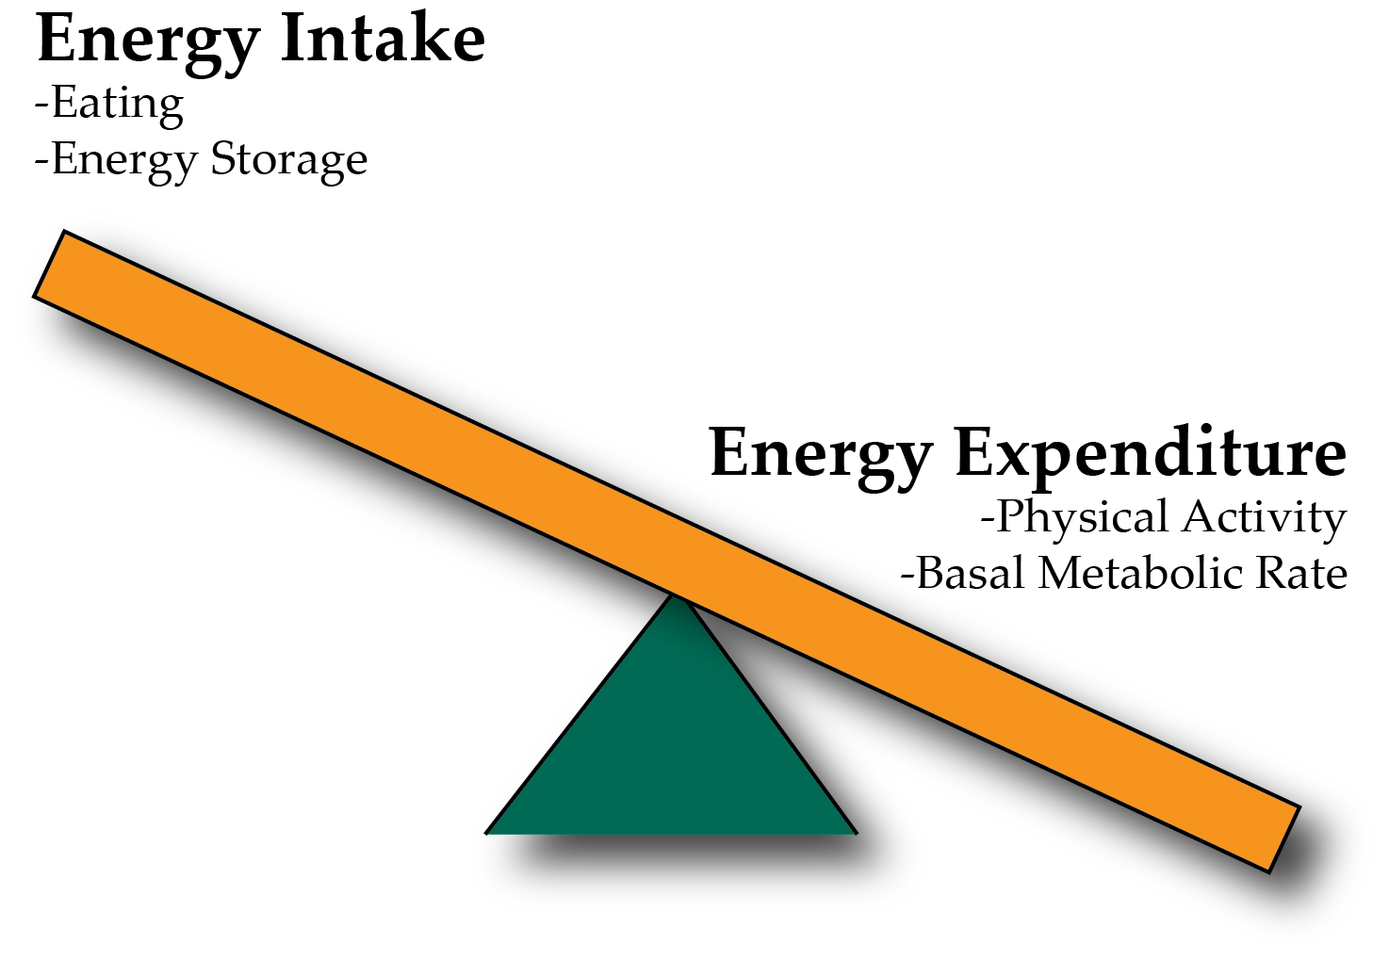
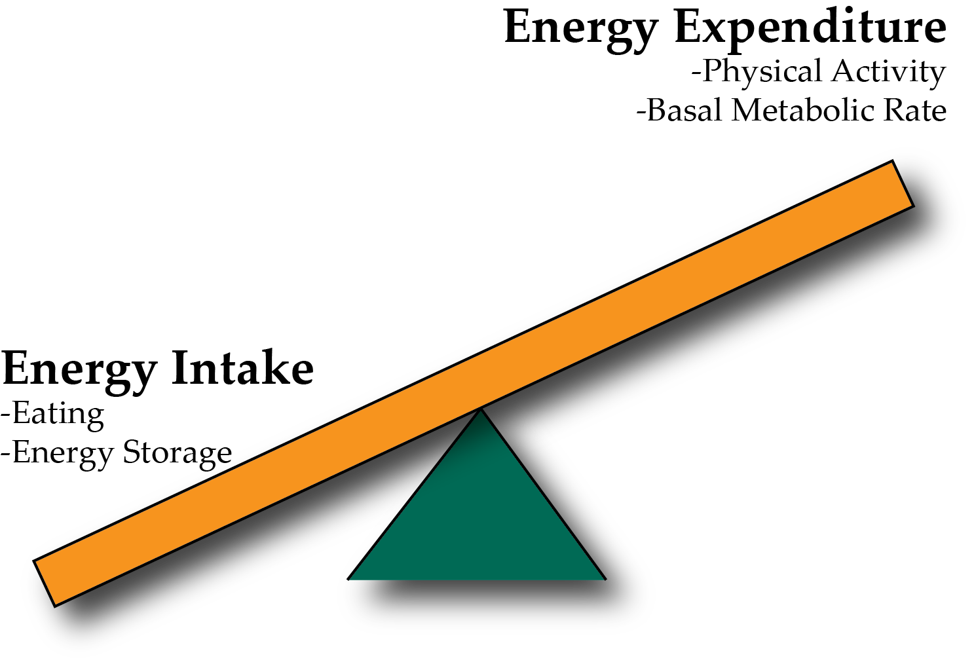
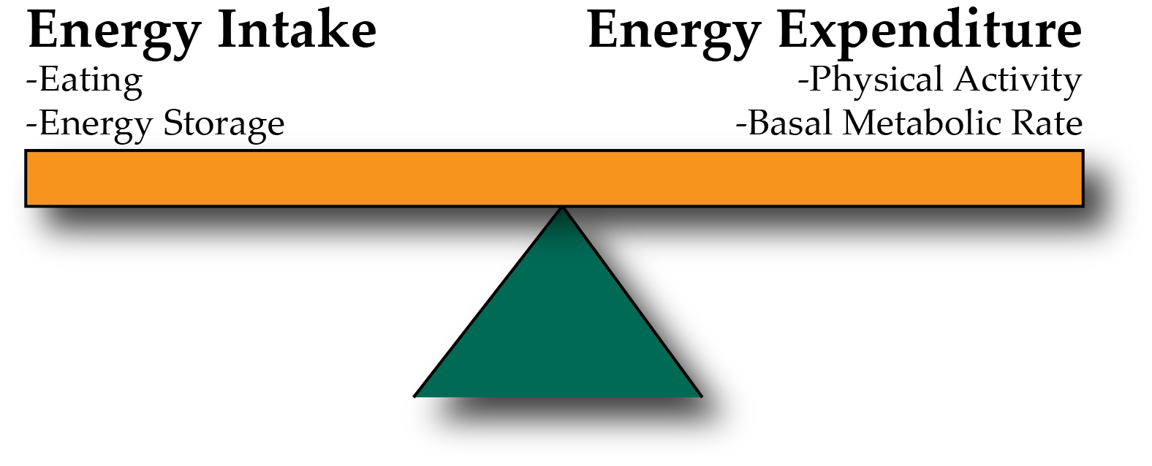
Energy Balance and Obesity
Positive Energy Balance – Weight Gain
Negative Energy Balance – Weight Loss
Notes:
Be here at 9:20

Slide 22
What are some processes that might predispose someone to increased adiposity

Slide 23
Identification of Leptin as a Rare Syndromic Form of Obesity
Montague CT, Farooqi IS, Whitehead JP, Soos M a, Rau H, Wareham NJ, Sewter CP, Digby JE, Mohammed SN, Hurst JA, Cheetham CH, Earley a R, Barnett a H, et al. Congenital leptin deficiency is associated with severe early-onset obesity in humans. Nature. 1997; 387: 903–8. doi: 10.1038/43185.
Notes:
Most syndromic forms are identified in children. Why?

Slide 24
Leptin is an appetite suppressant from fat tissue

Slide 25
Leptin deficiency is treatable with recombinant leptin
Farooqi IS, Jebb SA, Langmack G, Lawrence E, Cheetham CH, Prentice AM, Hughes IA, McCamish MA, O’Rahilly S. Effects of recombinant leptin therapy in a child with congenital leptin deficiency. N Engl J Med. 1999; 341: 879–84. doi: 10.1056/NEJM199909163411204.

Slide 26
Most syndromic forms of obesity associate with appetite control
Common Name | Locus | Heritability | Occurrence
Leptin | LEP | Autosomal Recessive | Extremely Rare
Leptin Receptor | LEPR | Autosomal Recessive | 3% of Early Onset Obese
Melanocortin (α-MSH) | POMC | Autosomal Recessive | Extremely Rare
Melanocortin Processing | CPE | Autosomal Recessive | Extremely Rare
Melanocortin Receptor | MC4R | Autosomal Dominant | 1-6% of Early Onset, 0.1-0.2% of Total Population
WAGRS Syndrome (Obese) | BDNF | Autosomal Dominant | 1:1,500,000
BDNF Receptor | NTRK2 | Autosomal Recessive | Extremely Rare
Prader-Willi | Several genes at 15q23 | Autosomal Dominant | 1:10,000
Barnet-Biedel Syndrome | Several BBS genes | Autosomal Recessive | 1:150,000
Notes:
BBS: 17,000 NFLD, 13,500 Bedoin in Kuwait

Slide 27
Role of Leptin, Melanocortin and BDNF in appetite control
Syndromic obesity variants generally cause over-eating

Slide 28
Discuss amongst yourselves
You come across a patient with severe, early onset obesity. They have a mutation in MC4R that blocks the ability of that receptor to function at all.
Would this person be expected to hyperphagic or anorexic? Why or why not?
Would leptin therapy be effective in this patient? Why or why not?
What other treatments might you suggest (either pharmacological or other).

Slide 29
Would this person over- or under-eat
Eat More
Eat Less
Eat the Same

Slide 30
Would this person be treatable by leptin?
Yes
No
Maybe?

Slide 31
Any thoughts how this information might affect treatment obesity?

Slide 32
GWAS and common variants associated with obesity

Slide 33
Most Common Variants Have Small Effects
Locke AE, Kahali B, Berndt SI, Justice AE, Pers TH, Day FR, Powell C, Vedantam S, Buchkovich ML, Yang J, Croteau-Chonka DC, Esko T, Fall T, et al. Genetic studies of body mass index yield new insights for obesity biology. Nature. 2015; 518: 197–206. doi: 10.1038/nature14177.
Notes:
FTO is the biggest each additional minor (risk) allele is associated with a 0.39 kg/m² higher BMI (equivalent to 1,130 g for a person of 1.70m tall)

Slide 34
Genetic Risk Scores and Obesity Risk
Genetic Risk Score
Sum of all BMI-associated alleles
Graph compares risk of BM >30 as a function of your percentile of risk score
Khera, A. V. et al. Genome - wide polygenic score to identify a monogenic risk - equivalent for coronary disease. bioRxiv (2017). doi:10.1101/218388
Notes:
Might be a good research topic, to ask whether we should implement genetic risk scores for obesity in identifying at risk individuals

Slide 35
Obesity – Disease Relationships
Genes
Genes
Environment
Choices
Obesity
Poor Health
Environment
Choices

Slide 36
Fatalism?
How does what you learned today affect your thoughts on fate vs personal responsibility with respect to obesity?
In the long run, we shape our lives, and we shape ourselves. The process never ends until we die. And the choices we make are ultimately our own responsibility. – Eleanor Roosevelt
Notes:
Bring up the new York times article
How should we approach prevention and treatment
Treatments do require some personal responsibility, or individual tailoring

Slide 37
Learning Objectives
Understand the proportion of obesity that is heritable and how this was determined.
Explain the difference between the effects of inherited environment and genetics.
Understand the role of the environment in the heritability of obesity.
Discriminate between the methodologies used to identify rare and common obesogenic variants.
Apply knowledge of obesogenic variants to potential individualized treatments.

